Slide 1

Classification Trees
Team Theta: Max Meneses, Patrick Poehailos, Jake Seefeldt, Shea Thomas
Notes:
Packages:
Gini < DescTools, rpart,
Entropy < C50,

Slide 2

Agenda
Tree Terminology Review
Classification Trees
Growing Metrics
Walkthrough
Churn Example
Group Work

Slide 3
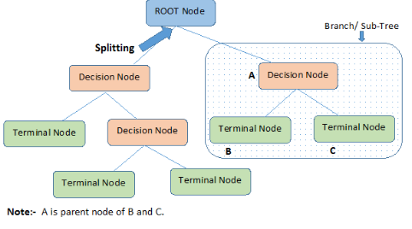
Tree Terminology Review
Root Node → entire population or sample
Splitting → dividing a node into two or more sub-nodes
Decision Node → sub-node that splits into further sub-nodes
Leaf/Terminal Node → nodes that do not split
Pruning → removing sub-nodes of a decision node (opposite process of splitting)
Branch/Sub-Tree → sub-section of entire tree
Parent and Child Node → a node that is divided into sub-nodes (children)
Notes:
https://www.analyticsvidhya.com/blog/2016/04/complete-tutorial-tree-based-modeling-scratch-in-python/
https://www.xoriant.com/blog/product-engineering/decision-trees-machine-learning-algorithm.html

Slide 4
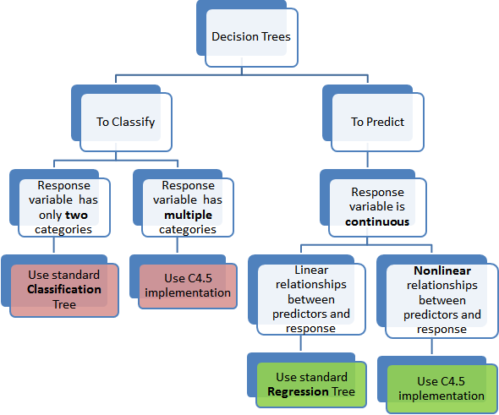
Regression vs. Classification Trees
Regression trees Quantitative
Classification trees Qualitative
Classification trees predicts common classes
Cannot use MSE or RSS, have alternative metrics to evaluate the trees
Notes:
Classification trees predict that each observation belongs to the most commonly occurring class of training observations in the region to which it belongs.

Slide 5

Classification Error Rate
The fraction of the training observations in that region that do not belong to the most common class:
ṕ_{mk} represents the proportion of training observations in the mth region that are from class k
It turns out that the classification error rate is not sufficiently sensitive for tree-growing
Notes:
In the classification setting, RSS cannot be used as a criterion for making the binary splits. A natural alternative to RSS is the classification error rate. Since we plan to assign an observation in a given region to the most commonly occurring class of training observations in that region, the classification error rate is simply the fraction of the training observations in that region that do not belong to the most common class

Slide 6
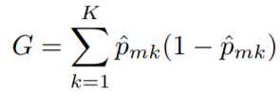
Gini-Index
The Gini-Index (GI) is defined by:
It’s a measure of the total variance across the K classes
The GI takes on a small value if all of the ṕ_{mk} are close to 0 or 1
Because of this, the GI is called a measure of node purity
Notes:
There are two other measures that are prefered than the Classification Error Rate, being the Gini Index and Entropy. They are both more sensitive to node purity that the classification error rate.
For example, a small value of ṕmk indicates that a node contains predominantly observations from a single class
Gini index says, if we select two items from a population at random then they must be of same class and probability for this is 1 if population is pure. It works with categorical target variable “Success” or “Failure”. It performs only Binary splits Higher the value of Gini higher the homogeneity. CART (Classification and Regression Tree) uses Gini method to create binary splits.

Slide 7


Entropy
Entropy measures the same homogeneity as Gini, and often closely tracks it:
The sum D is also considered the Information of the dataset; we want a value close to 0.
We can also assess the entropy of a certain split, and compare it to the pre-split data to determine proper building splits:
Notes:
(sometimes referred to as cross-entropy)
Measures the amount of randomness or uncertainty in the data
Intuitively, it tells us about the predictability of a certain event
In particular, lower values imply less uncertainty while higher values imply high uncertainty.
Example, consider a coin toss whose probability of heads is 0.5 and probability of tails is 0.5. Here the entropy is the highest possible, since there’s no way of determining what the outcome might be. Alternatively, consider a coin which has heads on both the sides, the entropy of such an event can be predicted perfectly since we know beforehand that it’ll always be heads. In other words, this event has no randomness hence it’s entropy is zero

Slide 8

Deviance
Used as an alternative metric
For classification trees, the deviance is given by the summary() function and can be calculated by:
n_{mk} is the number of observations in the mth terminal node that belongs to class k
A small deviance indicates a tree that provides a good fit to the (training) data
The residual mean deviance reported is simply the deviance divided by n − |T_{o}|
Notes:
It might be a bit clearer if we think about a perfect model with as many parameters as observations such that it explains all variance in the response. This is the saturated model. Deviance simply measures the difference in "fit" of a candidate model and that of the saturated model.
For a classification tree, residual sums of squares is not the most appropriate measure of lack of fit. Instead, there is an alternative measure of deviance, plus trees can be built minimising an entropy measure or the Gini index.

Slide 9
Why choose different metrics?
Gini Index | Entropy | Deviance
Intended for continuous attributes Minimize misclassification | Attributes that occur in classes Exploratory Analysis Slower to compute → Logarithmic Functions | How far predicted values from target
Notes:
Logarithmic functions are computationally intensive

Slide 10
Visuals of Gini-Index & Entropy

Slide 11
rpart( ~ . ,data= " ", method="class",
parms=list(split="information"), control=rpart.control
(minsplit=2,
minbucket=1, cp=0))

Slide 12
Visuals of Gini-Index & Entropy

Slide 13
Building Trees in R

Slide 14
Tuning Parameters - minsplit
Specifies the minimum number of observations in a node for which rpart will try to compute a split on
This parameter eliminates computation time since many small nodes will not be created
Default value is 20

Slide 15
Tuning Parameters - minbucket
Specifies the minimum number of observations that must come off of one side of the node
If either minsplit or minbucket is specified, the other takes a default value so that the relationship holds true
Default value is 7

Slide 16
Tuning Parameters- Max Depth
Determines the Maximum Depth of the tree from it’s terminal leaves (root node = 0)

Slide 17
Tuning Parameters - surrogate
Surrogate splits: How to decide a bucket with missing data
Goal: Find a different variable that can create roughly the same split
usesurrogate: whether to use surrogates:
0 = display only (do not classify missing values at splits)
1 = use surrogates (do not classify if all surrogates missing)
2 = if all surrogates are missing, send in majority direction
maxsurrogate: how many surrogates to be computed
Value of 0 minimizes run-time

Slide 18
Tuning Parameters - Complexity Parameter
Controls the process of pruning a decision tree
Governs the minimum “benefit” that must be gained at each split of the decision tree in order to make a split worthwhile
Saves computation time
Default value is 0.01. A value of 0 will build a complete tree to max depth

Slide 19
Tuning Parameters - Complexity Parameter
What is it doing
Looking for the number of splits where the Xerror is minimum
Xerror
Cross validation error relative to the root node error
Rpart has cross validation built in!
Notes:
Each row represents a different height of the tree. In general, more levels in the tree mean that it has lower classification error on the training. However, you run the risk of overfitting. Often, the cross-validation error will actually grow as the tree gets more levels (at least, after the 'optimal' level).
A rule of thumb is to choose the lowest level where the rel_error + xstd < xerror.

Slide 20
Tuning Parameters- Priors
priors: vector of probabilities
proportions of the class in the population if known
Informs rpart of the natural split ratios in the hope of trying to reach them
Increasingly helpful the farther the split gets from 50/50 in data

Slide 21
Loss Matrix
Prediction
Prediction
Don’t Reject Null
Don’t Reject Null
Reject Null
Reject Null
Null True
Predicted not rainy, was not rainy | Predicted rainy, was not rainy
Predicted not rainy, was rainy | Predicted rainy, was rainy
Null True
0 | 1
10 | 0
Actual
Actual
Null False
Null False
loss = matrix(2,2), 0’s on the diagonal and positive weights for remaining values
Specifies penalties for different types of errors, adjusting priors
EX: type 2 error penalized 10 times as much as type 1 error
Notes:
Changing the cutoffs for the predictions -- types of error
Changing to relate certain types of error more heavily

Slide 22
Why use Decision Trees?
Simple to explain
Some people believe it better mirrors how humans make decisions
Can be displayed with a simple graphic
Can handle qualitative predictors without having to create dummy variables

Slide 23
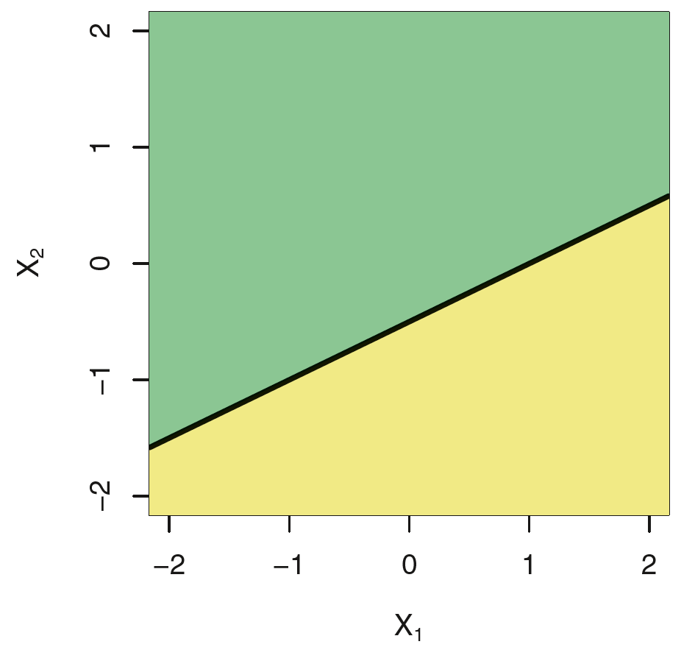
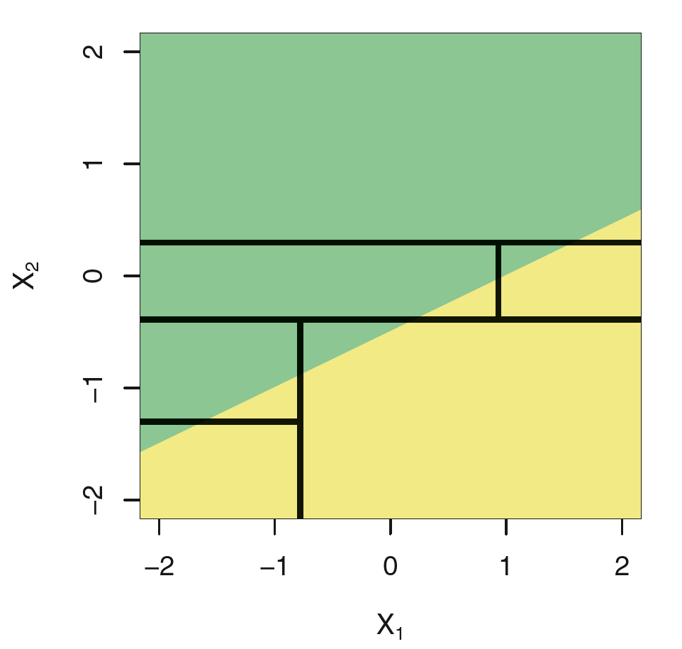
When are Decision Trees useful?

Slide 24
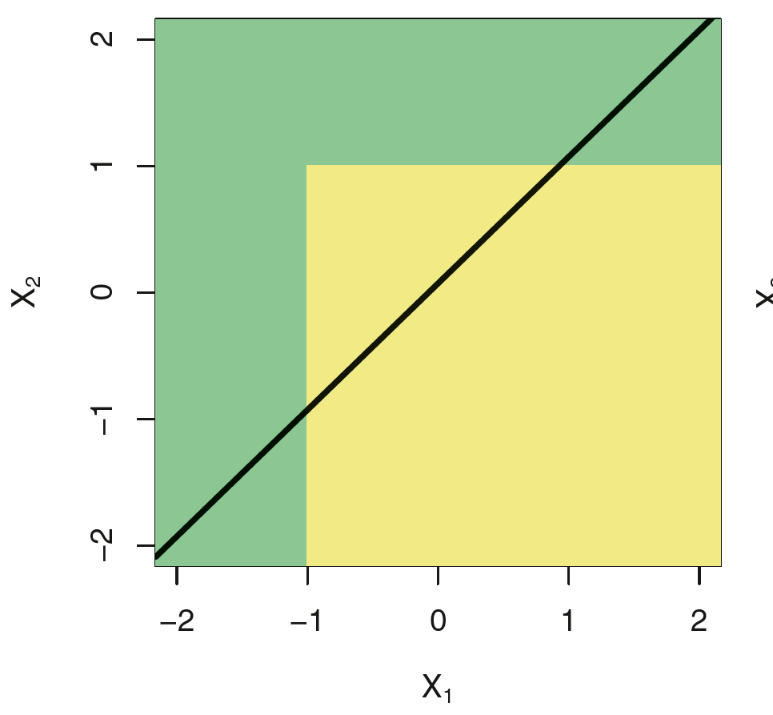
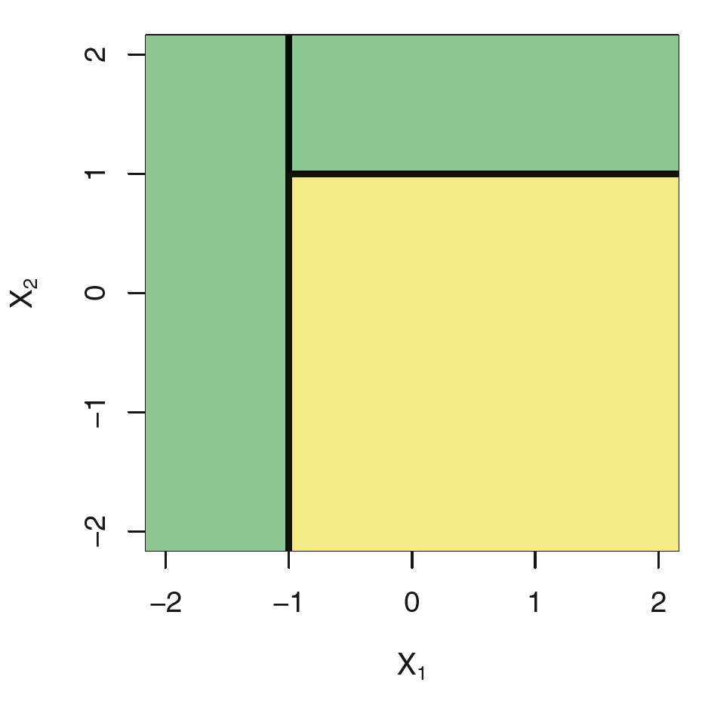
Are decision trees useful?

Slide 25
Takeaways
Build a tree and prune it back to the level with the lowest Xerror!
While still applying the one standard deviation rule
Kind in mind your type of error and your loss matrix
This is the building block for boosting, bagging, and random forests
Notes:
Each row represents a different height of the tree. In general, more levels in the tree mean that it has lower classification error on the training. However, you run the risk of overfitting. Often, the cross-validation error will actually grow as the tree gets more levels (at least, after the 'optimal' level).
A rule of thumb is to choose the lowest level where the rel_error + xstd < xerror.

Slide 26
Classwide peer programming!

